Slide 1

Github.com/
AhsanNawaz1

Slide 2
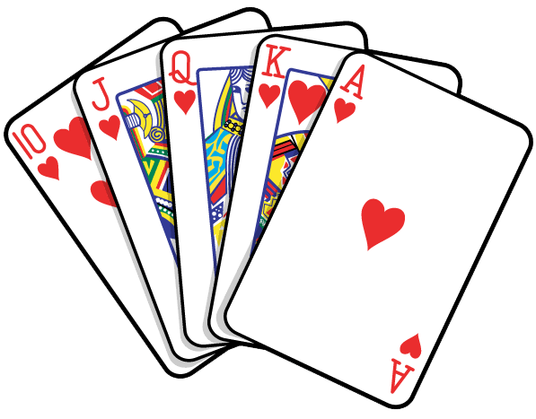
BLACKJACK
CARDS GAME

Slide 3
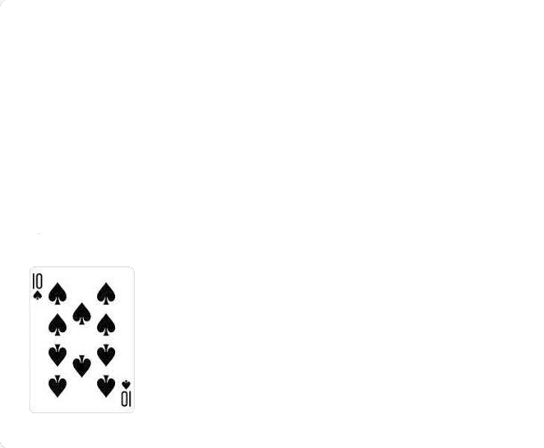
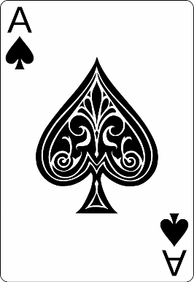
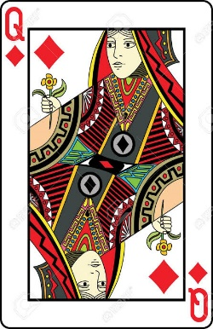
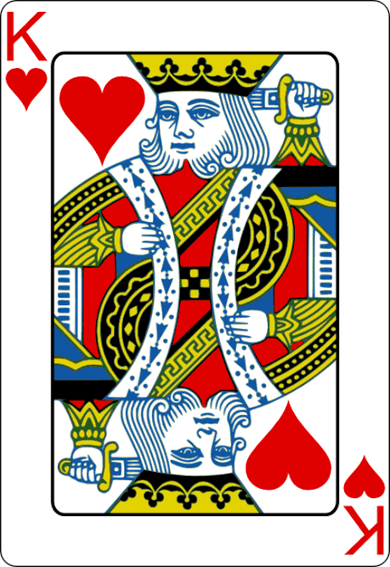
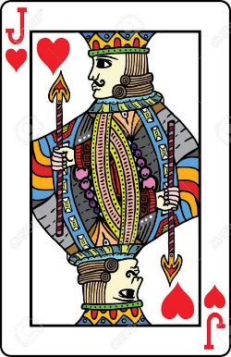
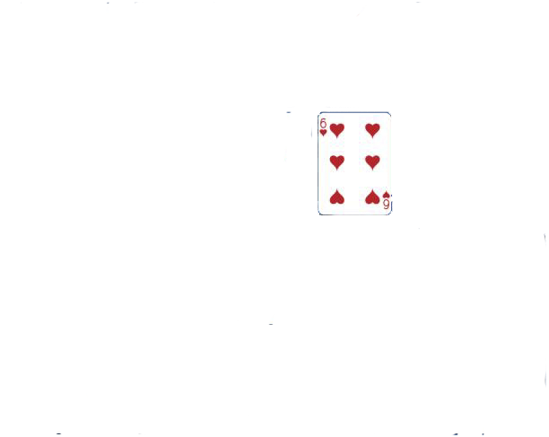
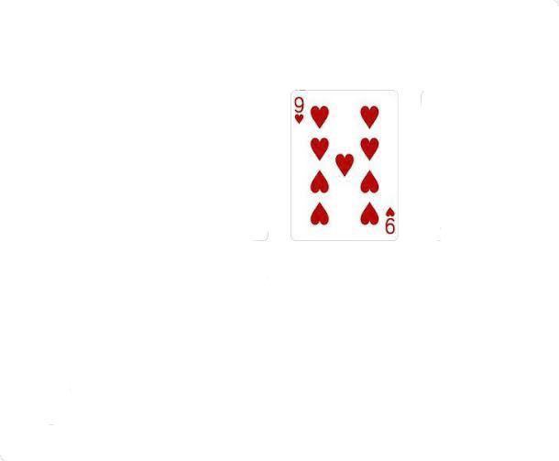
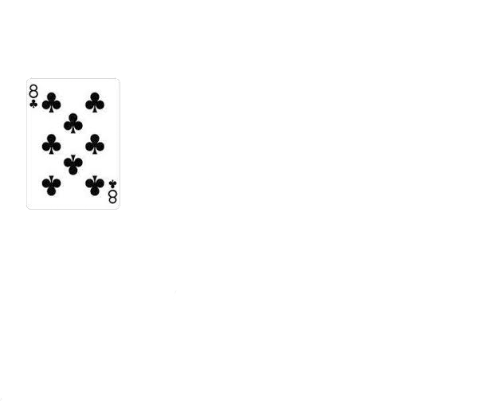
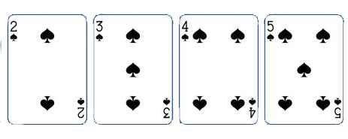
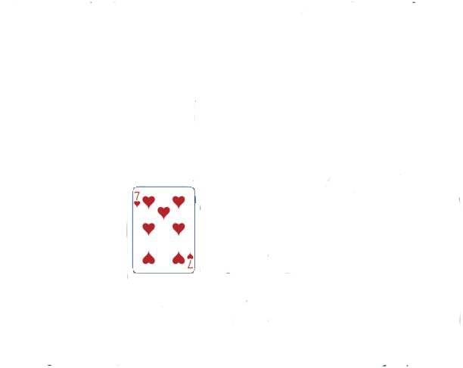
RULES
= 1 OR 11
=10
2 3 4 5 6 7 8 9 10

Slide 4
RULES
Goal is to get to as close to 21 without getting busted
Dealer starts with 2 cards → 1 face down
→ 1 face up
Human player with 2 face up cards

Slide 5

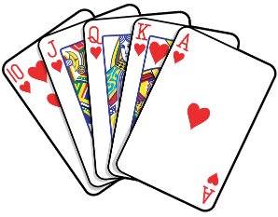

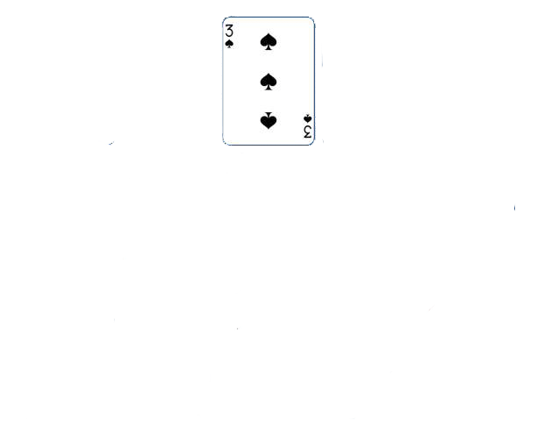
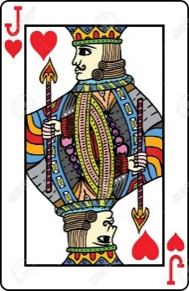
RULES
COMPUTER DEALER
48 cards remaining
Chips = 100
HUMAN PLAYER

Slide 6
Possible Actions
HIT (Receive another card)
STAY (Stop receiving cards)

Slide 7
POSSIBLE OUTCOMES
PLAYER BUST
COMPUTER WIN
PLAYER WIN

Slide 8
POSSIBLE OUTCOMES
PLAYER BUST

Slide 9
COMPUTER DEALER
9 →
= 13
HUMAN PLAYER

Slide 10
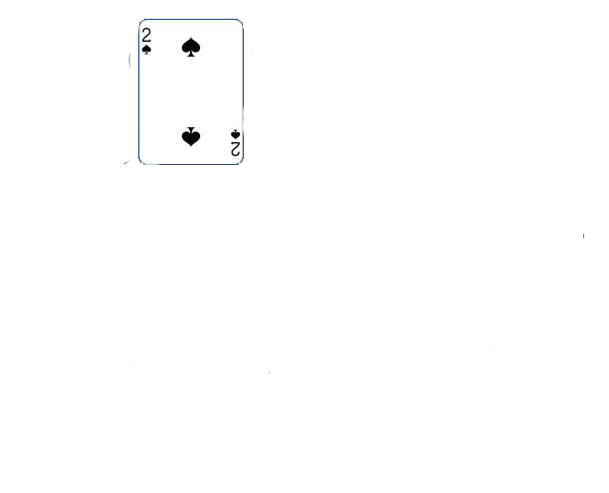
COMPUTER DEALER
9 →
= 15
HUMAN PLAYER

Slide 11


COMPUTER DEALER
9 →
= 25 busted
HUMAN PLAYER

Slide 12
POSSIBLE OUTCOMES
COMPUTER WIN

Slide 13
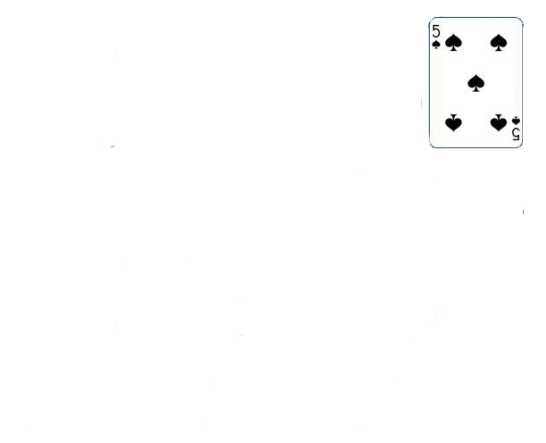
COMPUTER DEALER
9 →
= 18
HUMAN PLAYER

Slide 14
COMPUTER DEALER
= 15
= 18
HUMAN PLAYER

Slide 15
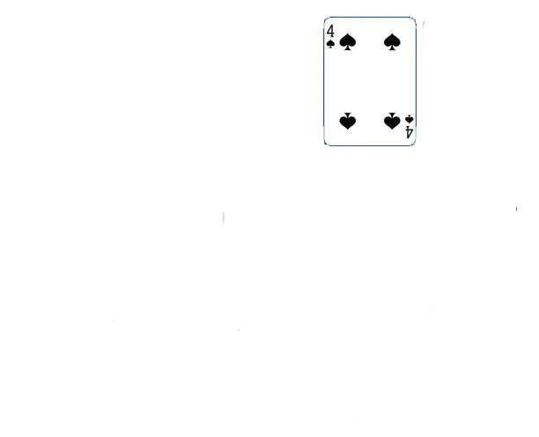
COMPUTER DEALER
= 19
= 18
HUMAN PLAYER

Slide 16
POSSIBLE OUTCOMES
PLAYER WIN

Slide 17
COMPUTER DEALER
9 →
= 20
HUMAN PLAYER

Slide 18
COMPUTER DEALER
= 17
= 20
HUMAN PLAYER

Slide 19

COMPUTER DEALER
= 27
= 20
HUMAN PLAYER

Slide 20
Algorithm
MiniMax is used.

Slide 21
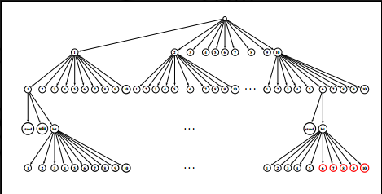
Game Tree

